Slide 1



An Introduction to
Tactile Sensing
Part II: implications for robotic tactile sensing and haptic display
Mark R. Cutkosky and Allison M. Okamura
Stanford University 12 January 2018
Notes:
My name is Santhi Elayaperumal, I am speaking on MRI-Compatible Haptics…using strain sensing to predict 3-dimensional needle bending in real-time.

Slide 2
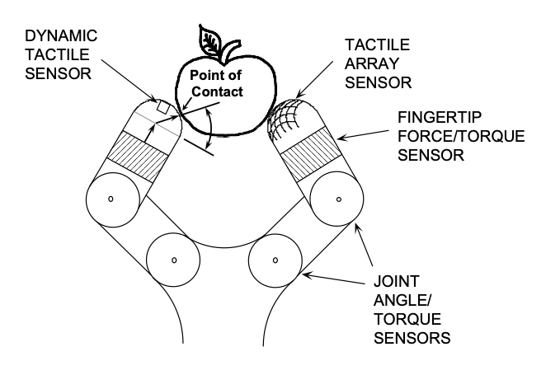
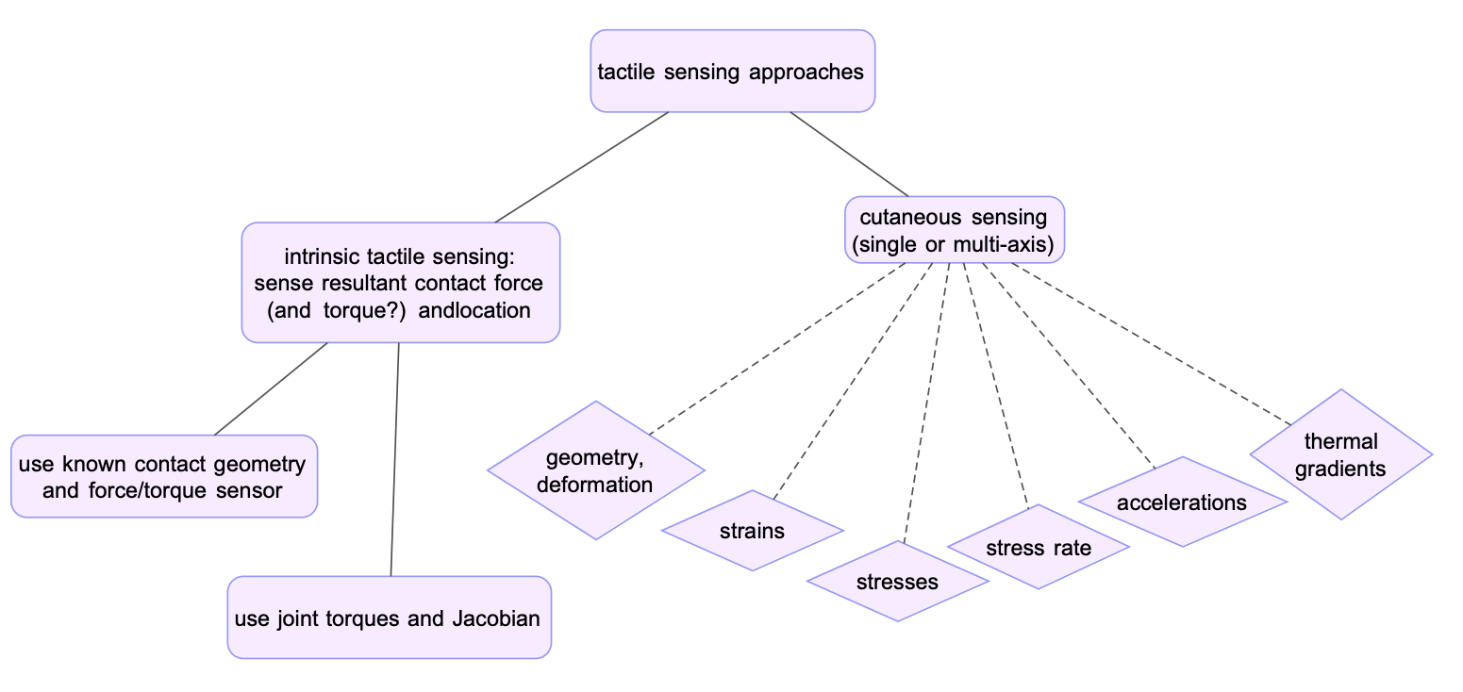
Possible sensing approaches
Why do we sense?
Exploration
Manipulation
Response

Slide 3
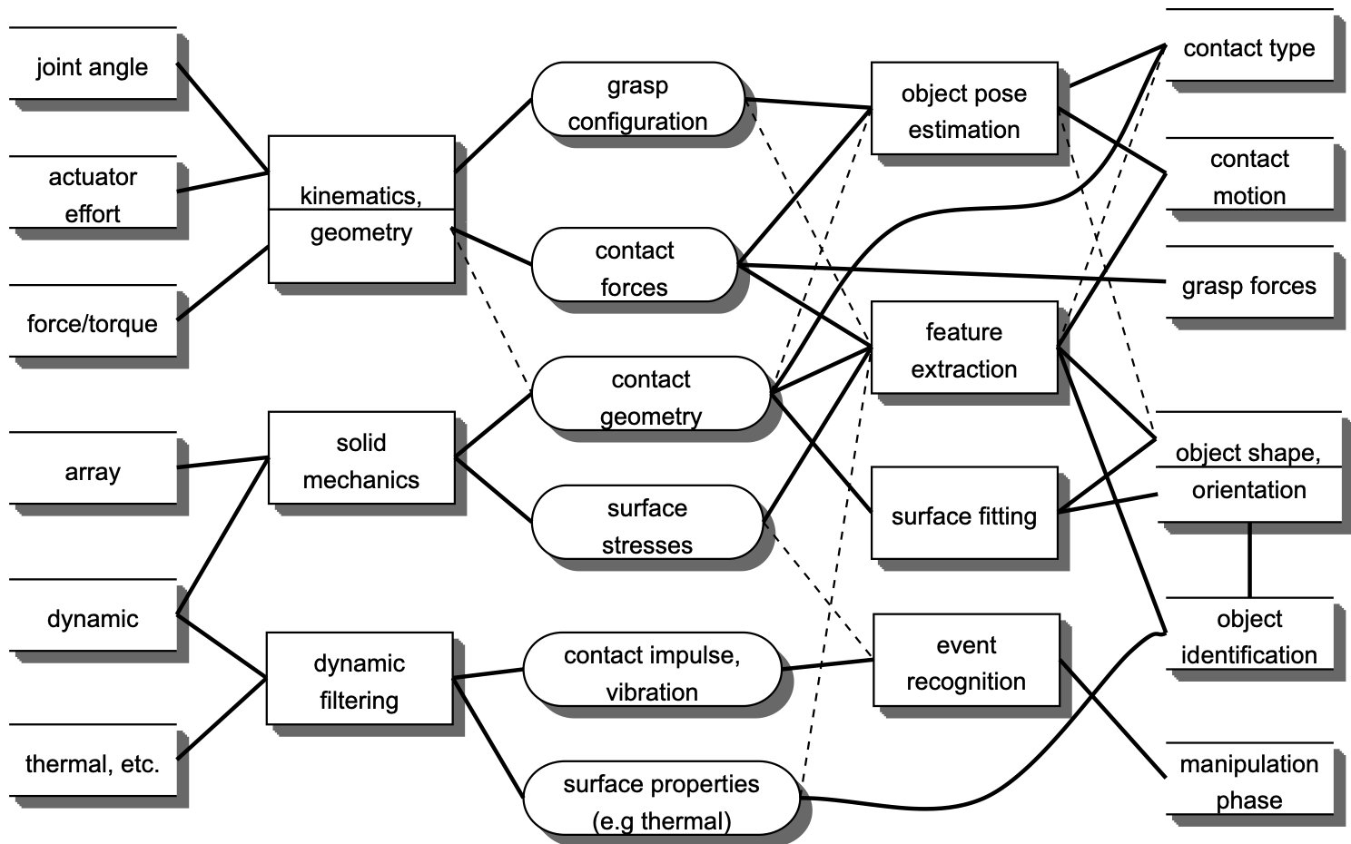
From sensed quantities to information
high
level
information
sensor
transformation
low level
information
interpretation

Slide 4
From sensed quantities to information
high
level
information
sensor
transformation
low level
information
interpretation

Slide 5
From sensed quantities to information
high
level
information
sensor
transformation
low level
information
interpretation

Slide 6
From sensed quantities to information
high
level
information
sensor
transformation
low level
information
interpretation

Slide 7
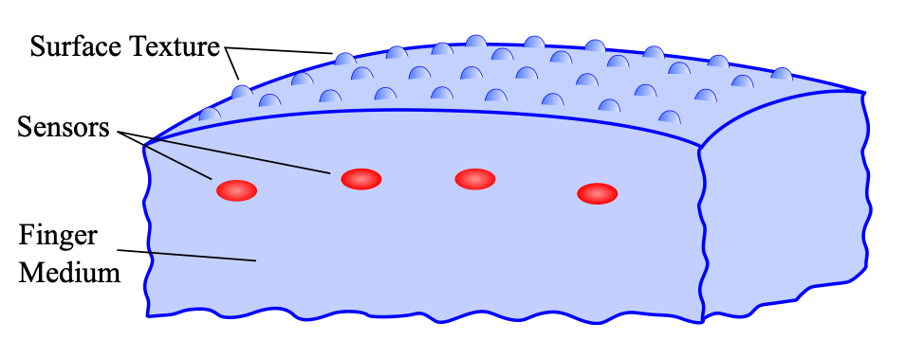
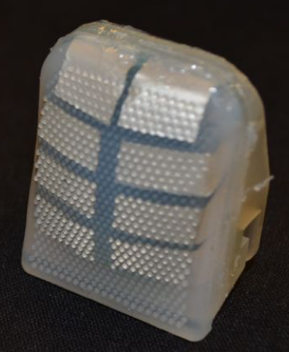
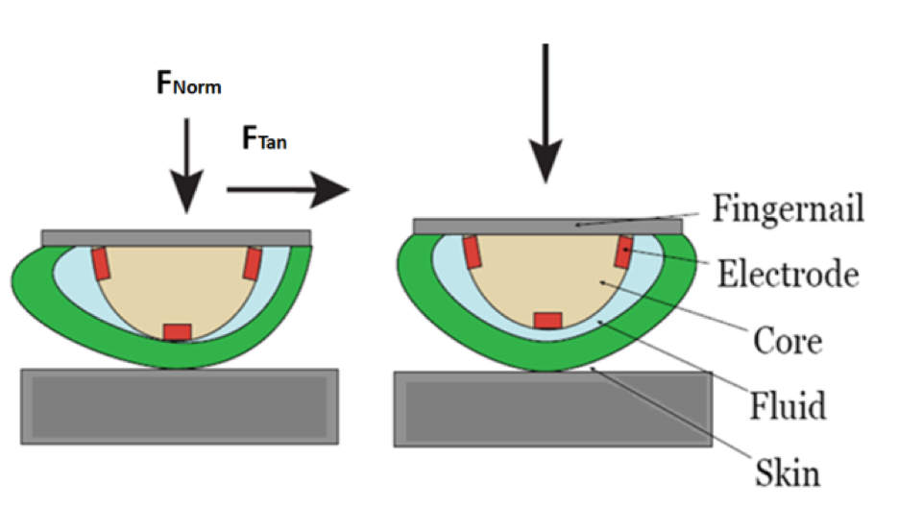

Few sensors measure stress directly
PVDF is much stiffer than surrounding silicone rubber, hence it essentially measures stresses in the material
In each case, the “receptive field” depends on skin design and sensor depth.
Other sensors essentially measure strains within the skin or finite deformations of the skin surface
BioTac sensor concept

Slide 8
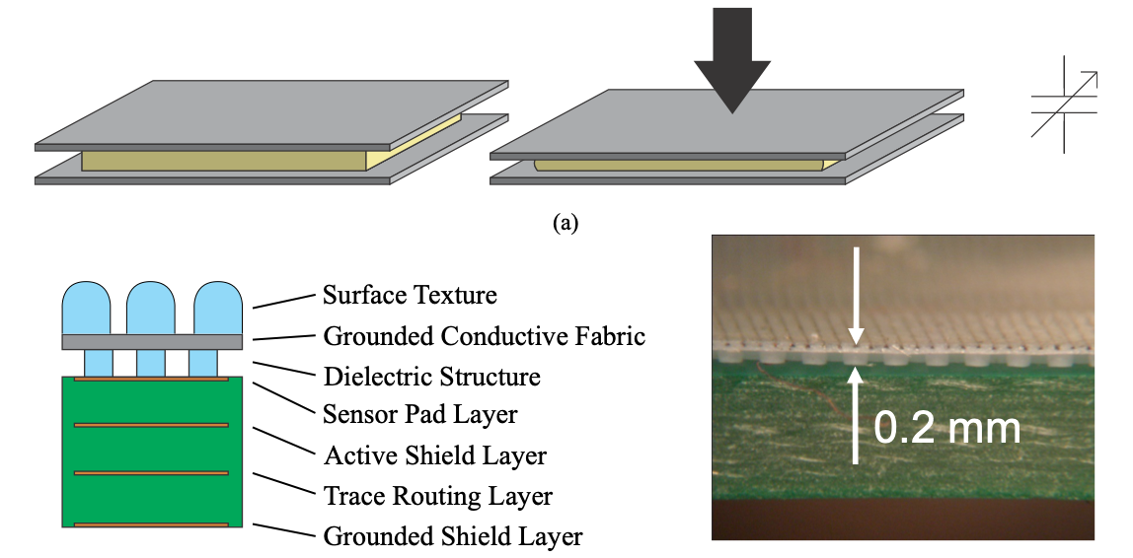
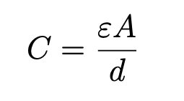
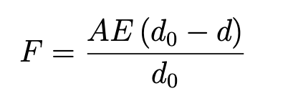
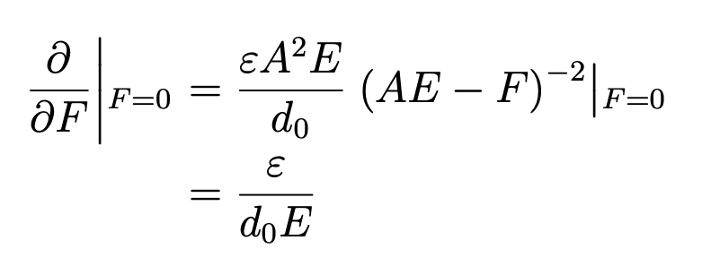
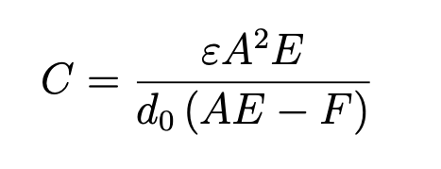
Capacitive sensing
Normal stress/strain scale nicely:
Sensitivity at low forces is independent of area, given appropriate choices of
dielectric (ε, E, d).

Slide 9
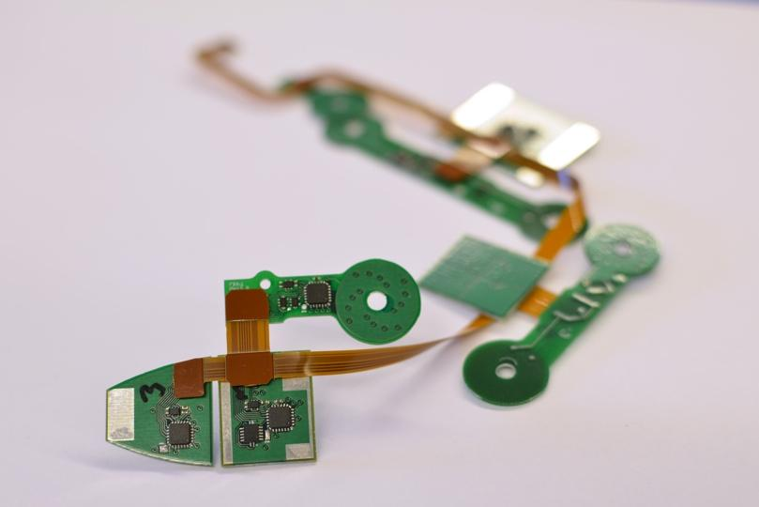
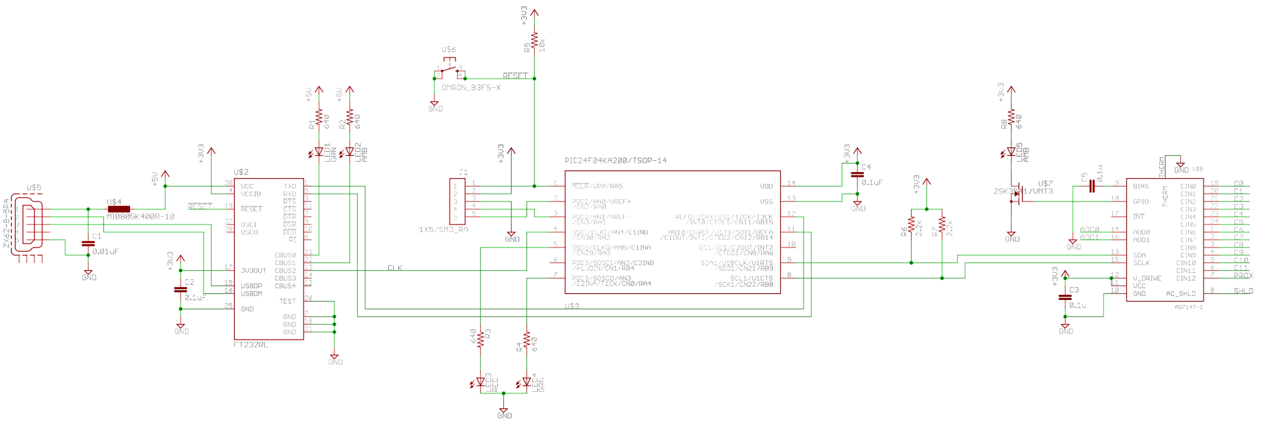
Integration and communication
USB
PIC
AD 7147-1
FTDI
Chips from smartphone industry etc.
provide active shielding, filtering
multiplexing, low-level communication

Slide 10
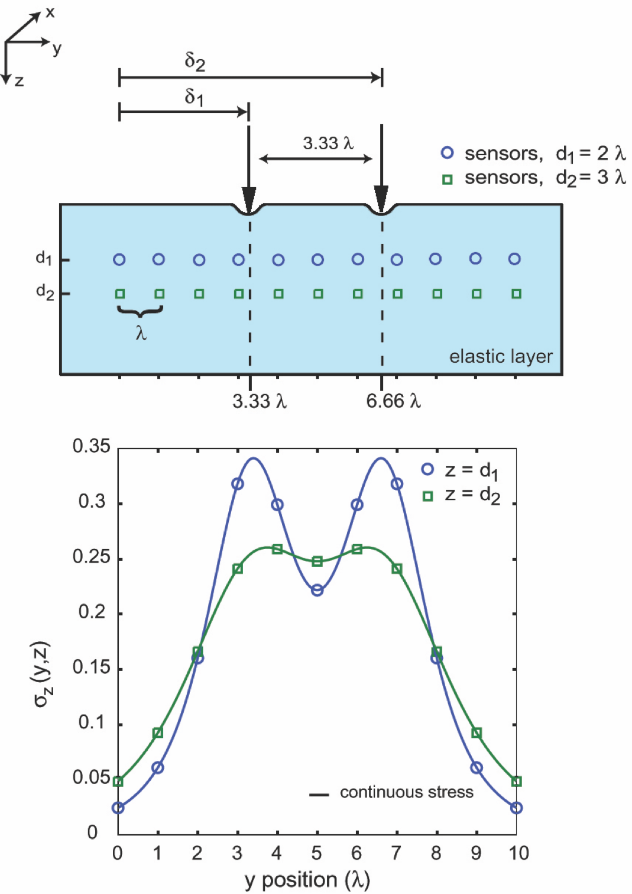
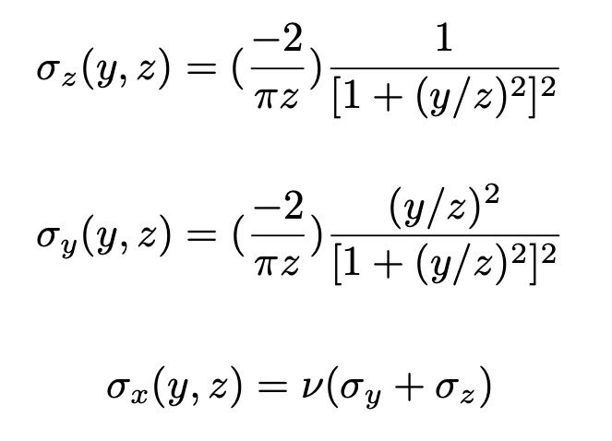
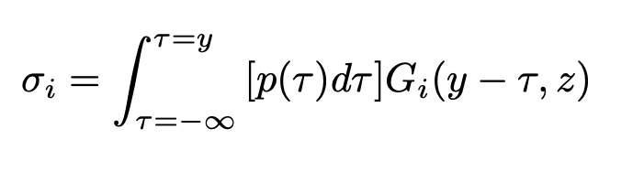
Effects of skin
Boussinesq line load (plane strain)
Solution for pressure distribution p(τ)
where Gi is the impulse response for
stress of interest:

Slide 11
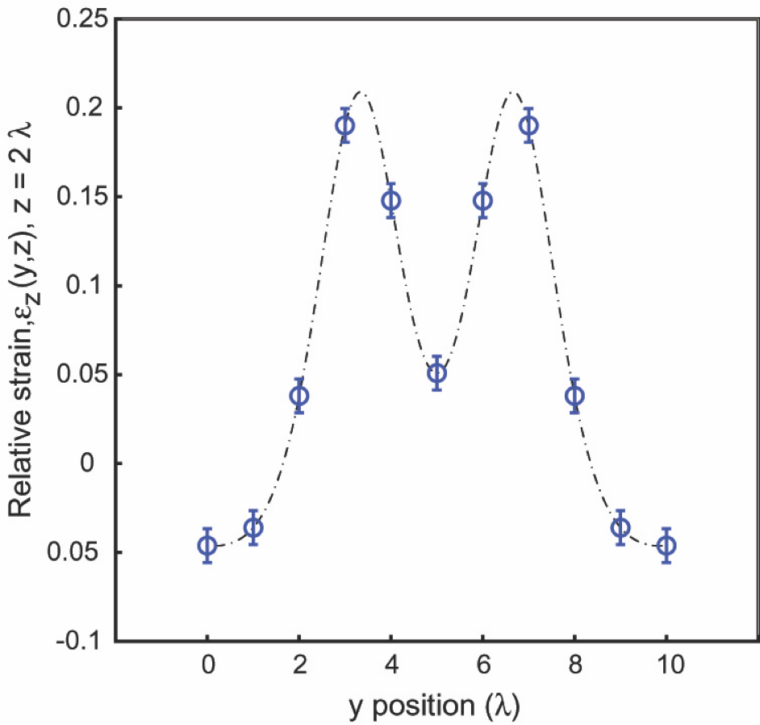
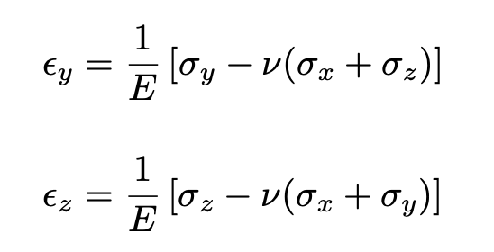
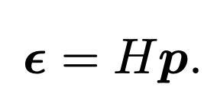
Strain at 2λ depth with 10% noise
Strains from stresses:
For a discrete set of
sensors below the surface
we will measure:
Where p is the discretized pressure
distribution and H maps surface
pressure to subsurface strains.

Slide 12
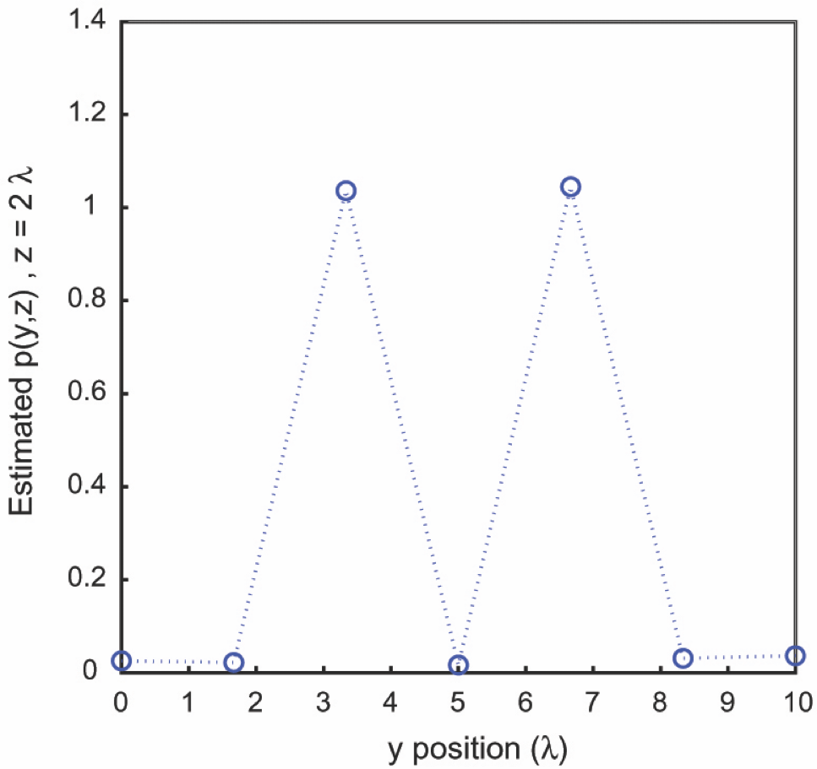
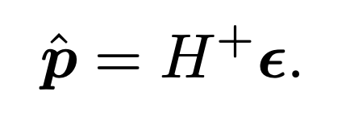
Reconstruction of surface pressure
where H⁺ is the pseudo-
inverse of H.
Dimension of p should
be less than
number of sensors.
Reconstructed pressure estimate for two line loads
for the case of 7 sensors at depth 2λ

Slide 13
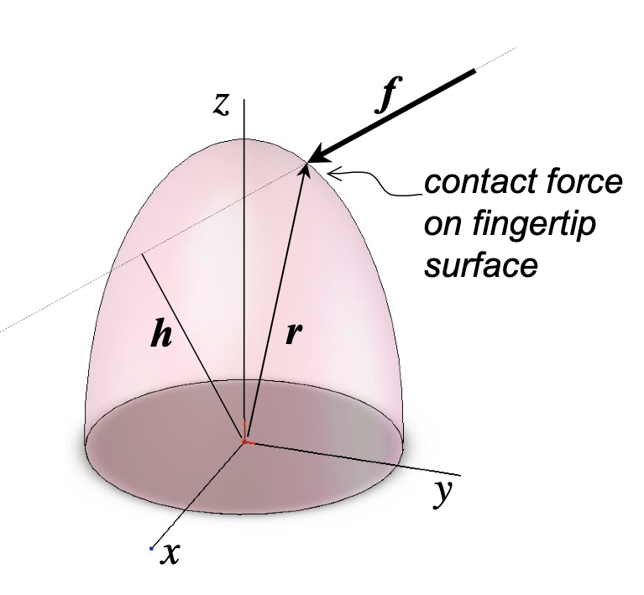
Intrinsic tactile sensing
reminiscent of the insect slit sensilla approach...
Use force/torque sensor and known
geometry (e.g., catheter tip)
to solve for magnitude, location
and direction of resultant contact force:
Measure f and τ = r × f,
Let h be the line of action:
(h/h) = (f/f) × (τ/τ)
where h = f/τ
r = h −αf and α is found from
intersection of line of action
with known finger geometry.
(Salisbury, Bicchi)
Advantage: typically able to use high quality and high bandwidth force and torque data
Limitation: assumes single resultant force, requires known geometry (not suitable for soft fingers)

Slide 14
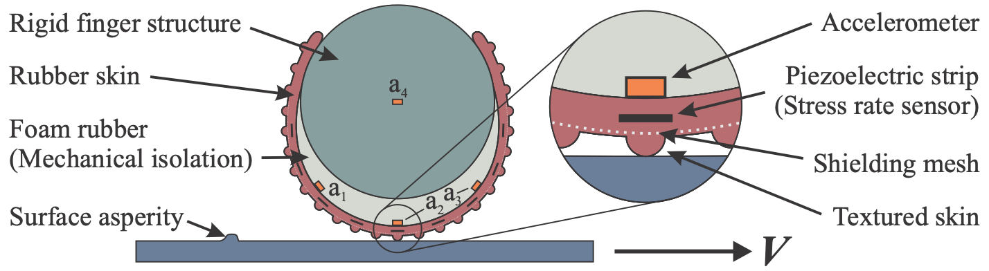
Dynamic tactile sensing
Approximating the FA-I and FA-II mechanoreceptors
Cutkosky, Mark R., and John Ulmen. "Dynamic tactile sensing." In The Human Hand as an Inspiration for Robot Hand Development, pp. 389-403. Springer, Cham, 2014.

Slide 15
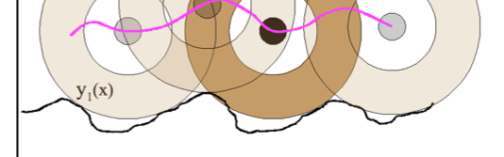
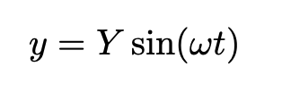
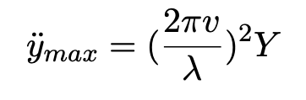
Skin acceleration sensing
Similar to Pacinian corpuscles (FA-II). Very sensitive to
vibrations of object or stylus held in hand
contact made or broken between finger and object
vibrations from small bumps or ridges on surface:
Assume finger or probe moves with velocity v over the surface, following bumps with an amplitude of Y and a wavelength of λ,
creating a traced surface:
Example: if v = 10cm/s and λ = 0.4mm (a little longer than a fingerprint ridge), the frequency of oscillation is 250 Hz (peak FA-II sensitivity).
For a height of Y = 10μm, the corresponding acceleration is about
25m/s² or (3/4) g.

